Slide 1
Using GitHub for Final Project

Slide 2
What is Git / GitHub?
Change-management System
Allows multiple users to work on the same code at the same time
Notes:
Git is a change management system that allows you to manage version control easily. This means that you and your partner can work on the same code at the same time and you don’t run the risk of accidentally overwriting each other.

Slide 3
Why Use GitHub?
1. Seamlessly Integrate Changes
2. Show off your Work
GitHub is a place to showcase the pieces of your portfolio
Notes:
You’re going to use GitHub in your final project for two reasons. 1) it should make life easier when sharing files if you both have copies of everything in the repo, and you can modify the documents at any time and then share them easily through Git. 2) You’ll place your entire project onto GitHub and it will be where your portfolio lives. You can include a link to GitHub on your resume, and they can check out all the files associated with your project, and see things like the amount of work you’ve put in and when you last updated things. This helps give you depth after your very breadth-driven bootcamp education!

Slide 4
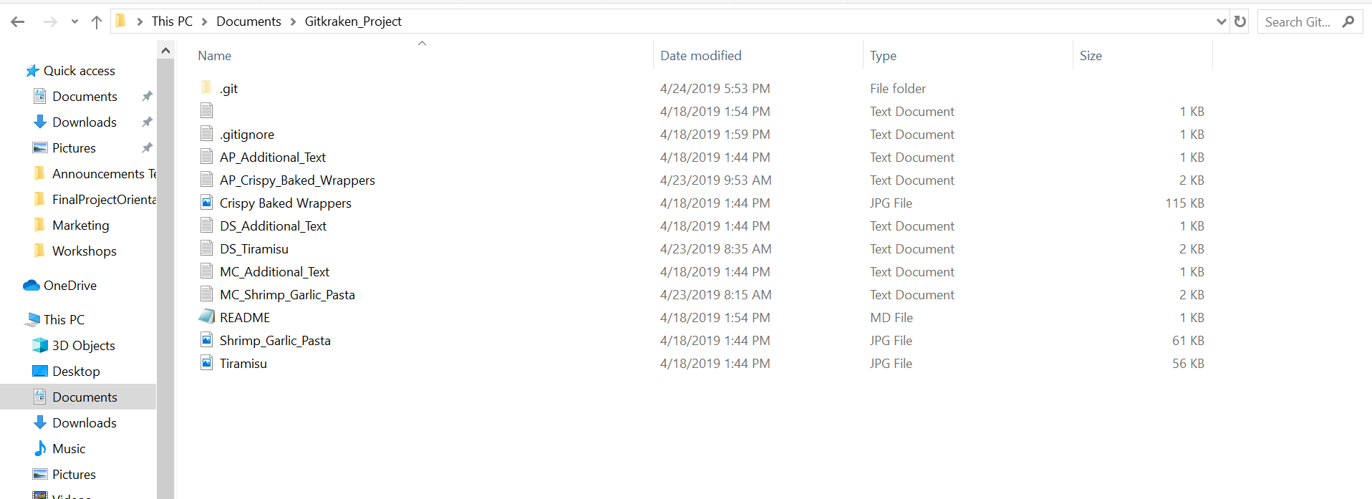
Once you’re Set Up…
Notes:
Once you have created your GitHub account and cloned your repository with GitKraken, it’s time to rock! Here’s an example of a project that I had set up as a sample for playing around a while back. It primarily consists of recipe information, but we’ll add some data stuff to it in a minute.
Here’s the secret that takes some time to understand – wherever you downloaded your Git repo to is where it lives locally on your computer! You have your very own version of these files at your fingertips. For instance, I chose to put mine in Documents and then in a folder called “GitKraken_Project,” but you can put yours anywhere. And it supports all type of files – not just text documents. You can see here that I have some images. But I can also add my data files for R or Python, or I can add PPT.

Slide 5
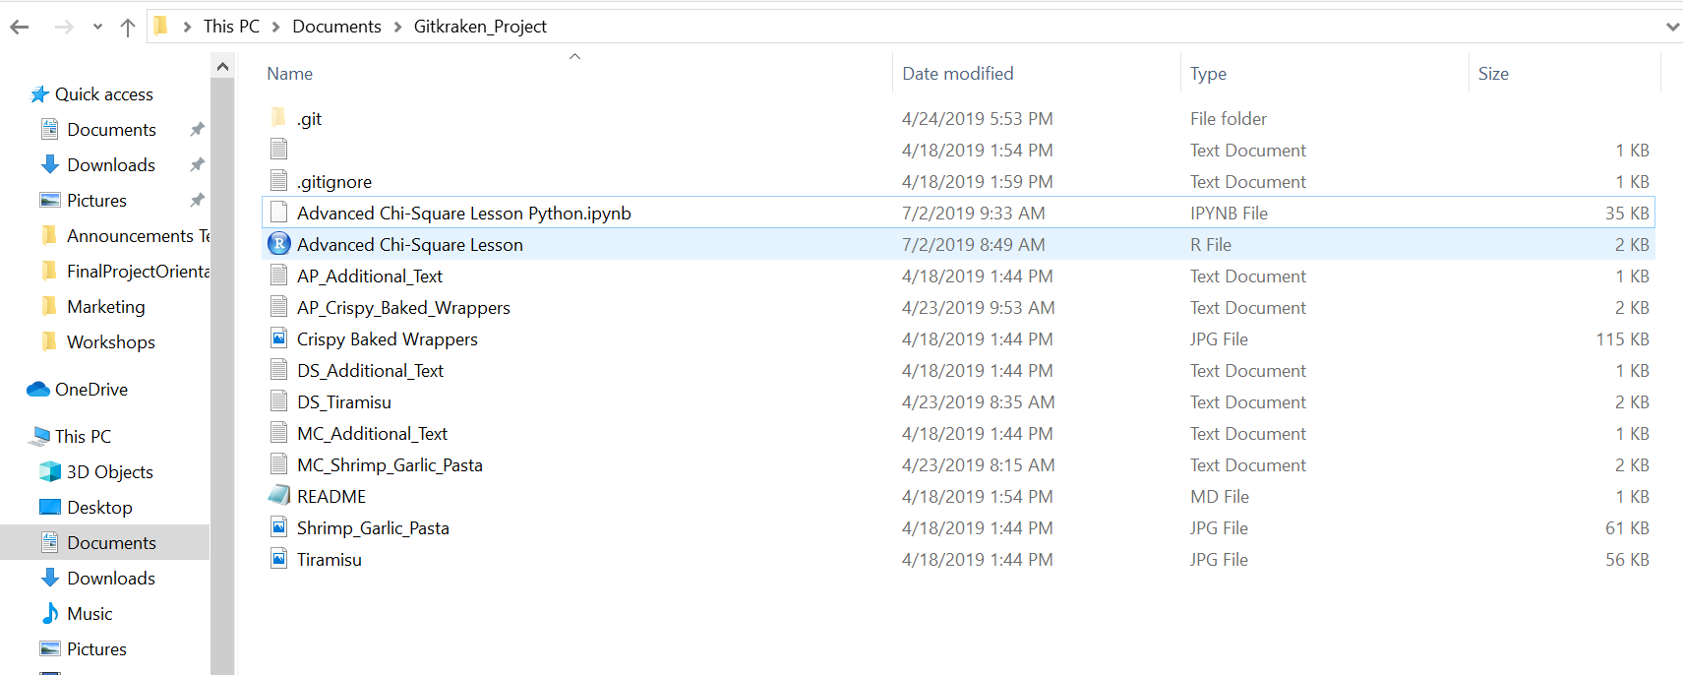
Drag and Drop Files in
Notes:
Looking again, you can now see that I just dragged and dropped some files in here – Advanced Chi-Square Lesson Python.ipynb and Advanced Chi-Square Lesson, which is an R File. You could also copy and paste, but there’s no need to keep replications of these files hanging around, because GitHub keeps them nice and safe on a server once you push. The idea I want you to grab here is that your code can live in this GitHub folder at all times.

Slide 6
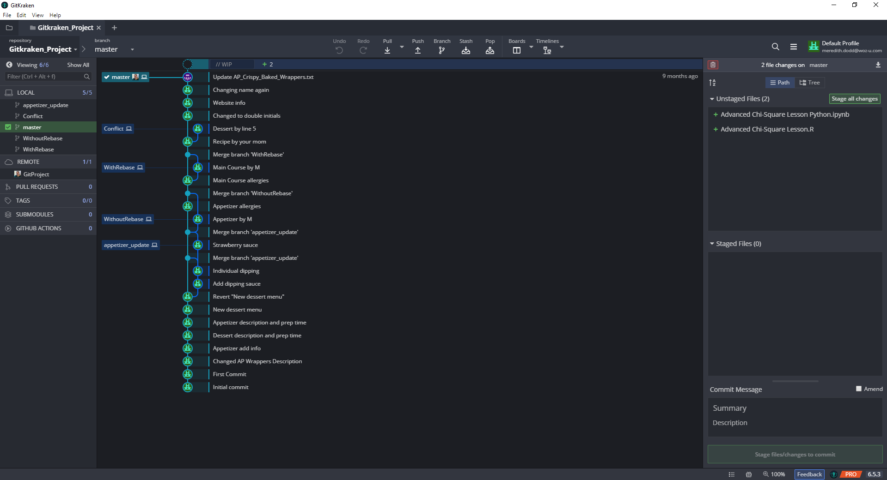
Open Changes in GitKraken
Notes:
Next, you want your work to be available to your partner, and ultimately, to the world! So documents living in your local folder do you no good. You have to push them up in GitKraken to share them! When you open up GitKraken, if you only have the one repository (which you should if you followed the curriculum and are new to GitHub), then you’ll see it selected in the upper left-hand corner under “repository.” Notice that this name is the SAME NAME as your file folder!
Then, it shows you on the right that there are changes that have been made. You can see that both Chi-Square files are “Unstaged.” This means that they are ready to roll, and you’ve made changes to them, but nothing has happened yet with them. You haven’t prepared them (staged them) and you haven’t pushed them to the universe yet. They are just on your local computer.

Slide 7
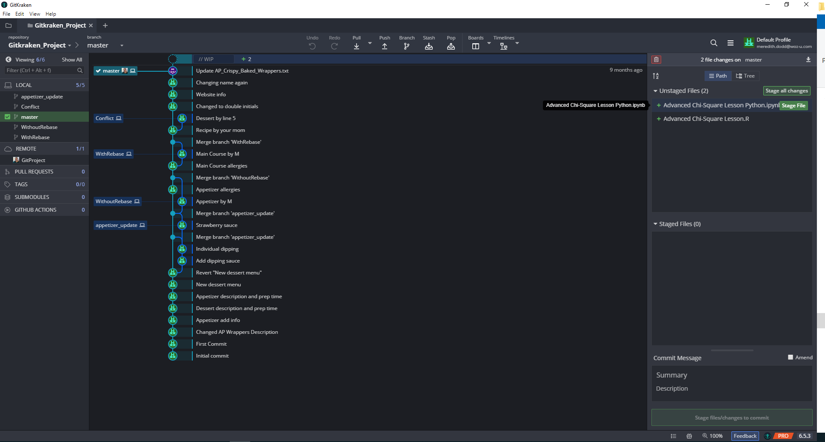
Stage Files
Notes:
To get the ball rolling, you will need to push buttons! Who doesn’t love pushing buttons?! Specifically the button or buttons you want to push and are green, in the unstaged files section. If you’re good to do them all at once, then you’ll want to “Stage all changes” and use the top button. This is great for just getting things in quickly, but if you make a lot of changes at once and there’s a problem with them or you need to undo them, then sometimes it can make things a little tricky. But breaking things up by file takes time. So it’s up to you how much you “chunk” your files up. When you’re working with a sprint, often there will be ticket numbers associated, and if that’s the case when you’re on the job, you will want to stage things by issue/ticket number.
In this case, I’m going to push all at once, but if you did need to do it file by file, you can hover over the file and you’ll see an individual push button for that file show up. It’s here, since I took a screenshot while hovering.

Slide 8
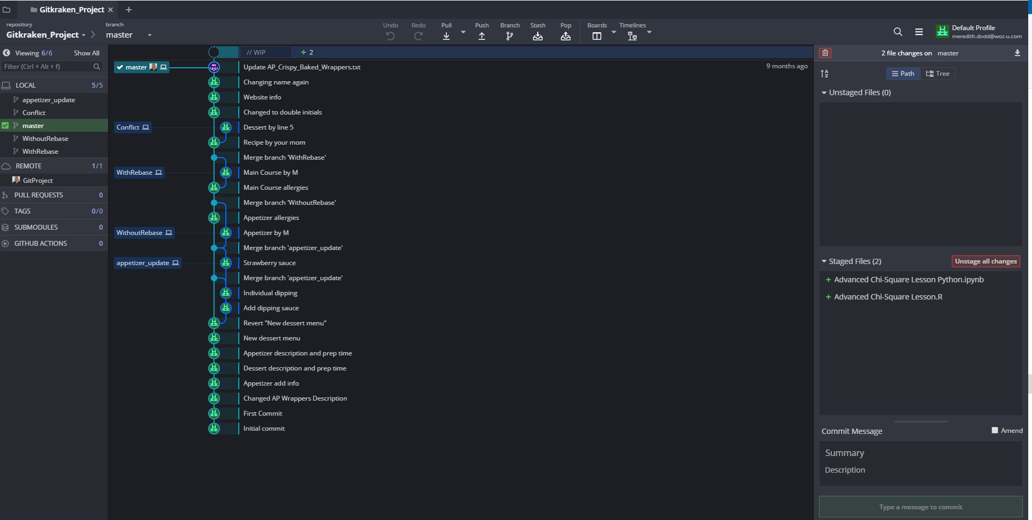
Commit
Notes:
Now files are in the “staged” section, once I’ve used that lovely button. This means that they are now ready to be committed. Just like you make a commitment to a loved one to always be there, once you commit your files, they are now a part of the GitHub system. You can write a message down below to showcase your love. Ahem. To say what your files include. Be descriptive, but concise.

Slide 9
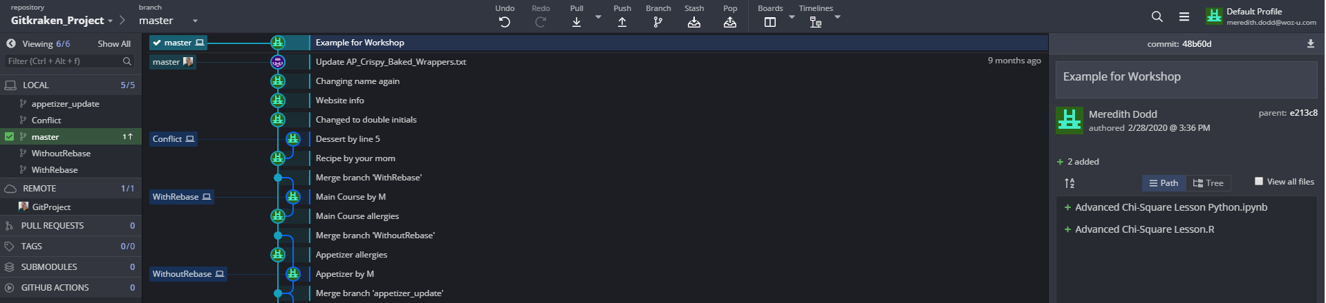
Examine Commit
Notes:
And then you’ll be able to see that commit with your text in the center section. If it’s highlighted, like it is here, then you can see what files went into the commit. Here you’ve got that good old Python and R file we’ve been working with all along! But you’re not done yet….

Slide 10
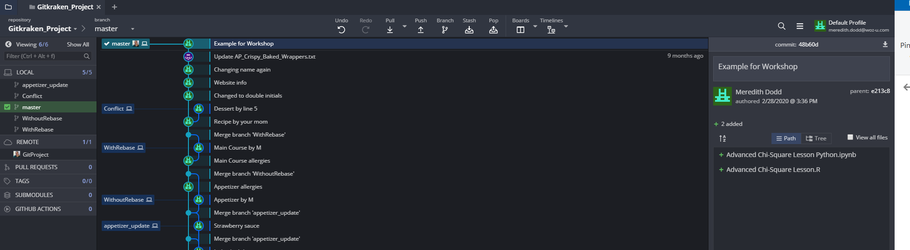
Push Changes
Notes:
The next step is to click on the push button at the top there. This is what takes things from being fully saved locally to being made publicly available, and ready for your partner as well. Once you push, you’ll get a little message at the bottom that says that things pushed successfully (not shown here, and it disappears fast, FYI), and you then you will see that now your little computer icon, which is local, is now at the same spot with your GitHub icon (mine’s my face). Flip back and forth from this slide to the last one – the last one has master on two lines – now they are on one! That means they are synched and pushed.

Slide 11
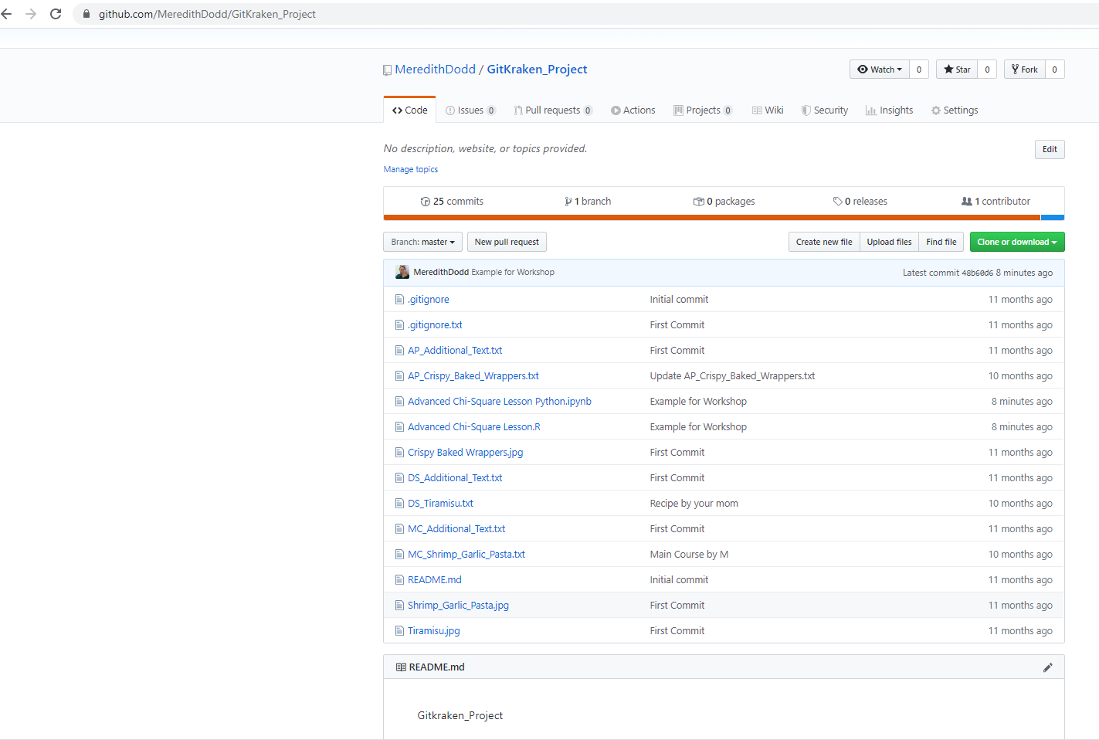
View on GitHub
Notes:
Now here’s where it comes full circle! Go to your GitHub account, and you’ll be able to see the changes that you made! This is what it will look like when a potential employer views your portfolio and your profile. They’ll be able to see the work you’ve done and all the files that went into it! See that in the middle, those “Advanced Chi-Square” files are listed, along with the name of the commit we made – Example for Workshop. You can click on those…like a potential employer would…and they can actually view all your code without downloading it. It’s especially in a

Slide 12
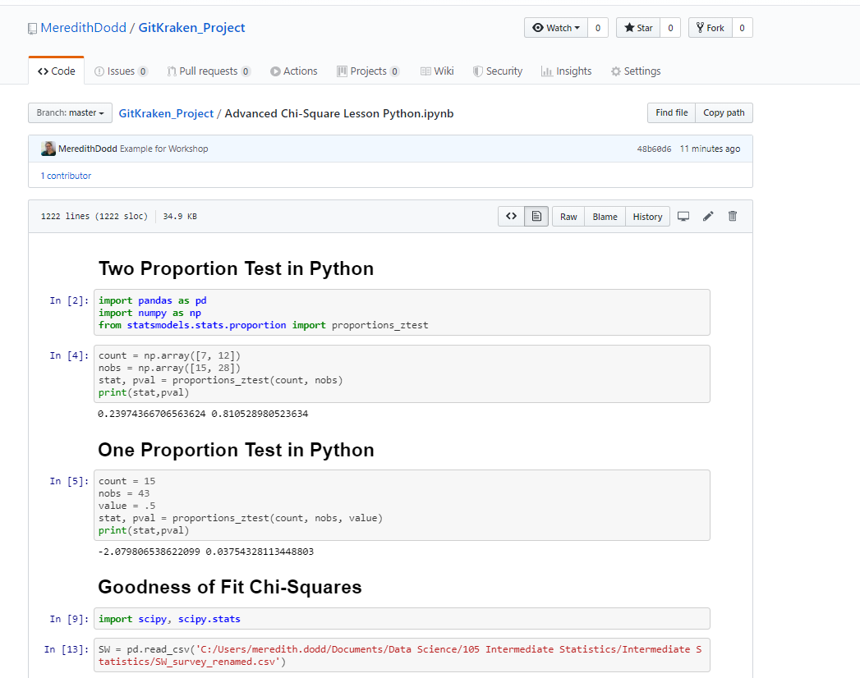
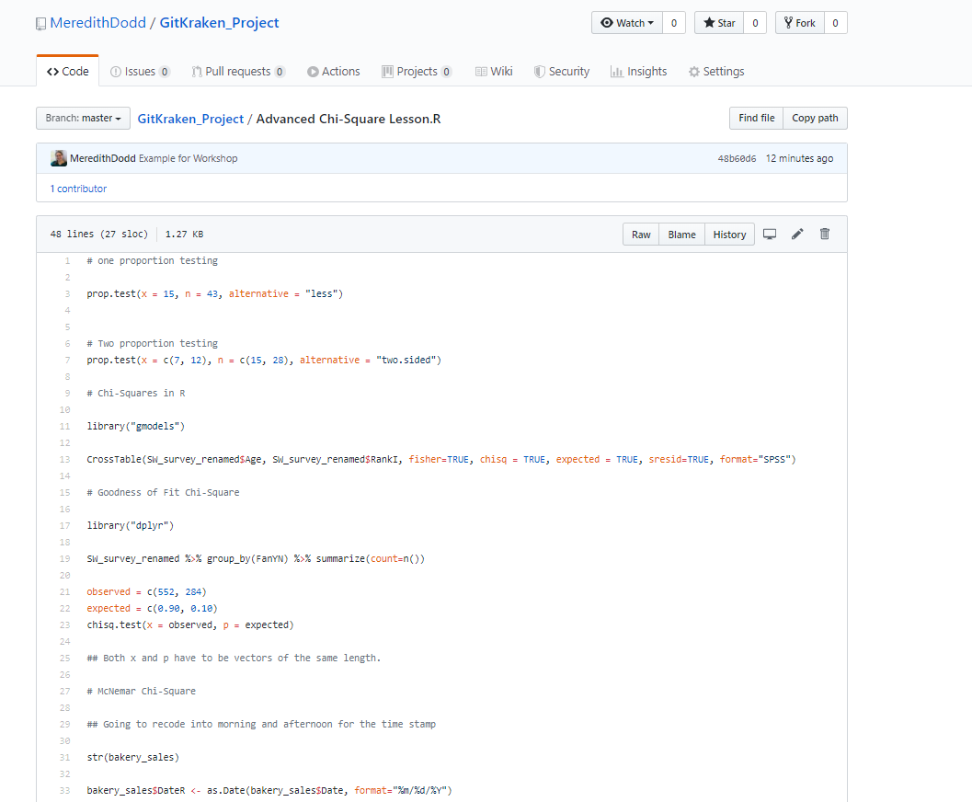
View Actual Files
Notes:
like a potential employer would…and they can actually view all your code without downloading it. It’s especially pretty in Jupyter (left), though it works in R too (right) and many, many other languages! So they can see a copy of your work without the ability to modify (they would need to clone and download your repository to modify). You can show everything off related to your project, including code files, data files, your presentation, your project proposal, and anything else you can think of! You can also make those files available for your partner!

Slide 13
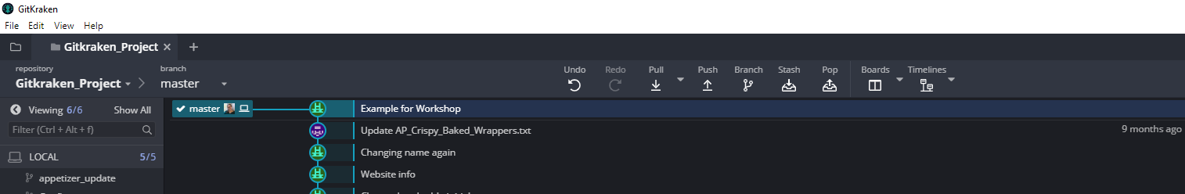
Pull Changes
Notes:
You can also make those files available for your partner! Once you’ve pushed to Git, your partner can then pull them down onto their local machine and make changes of their own. How? The handy dandy pull button next to the push button there. When there are changes made, to see them on your local computer, just pull once you’ve committed and pushed your own work, and you’ll have the latest version to work with.

Slide 14
















Questions?

